Slide 1
STU td
Project: Literature Tests

Slide 2
STU td
01
03
04
Our team
Planning stages
You can describe the topic of the section here
You can describe the topic of the section here
Our idea
Technologies
02
You can describe the topic of the section here
You can describe the topic of the section here

Slide 3
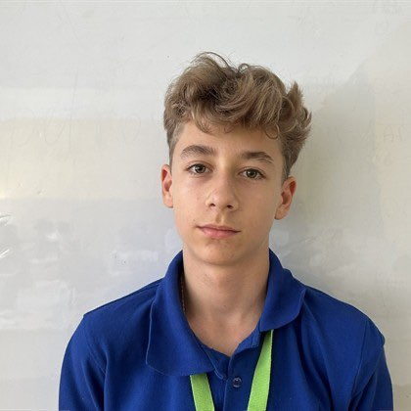
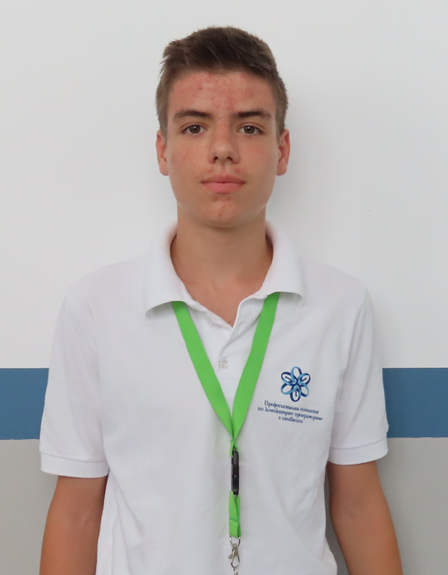
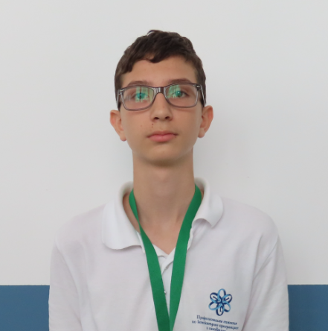
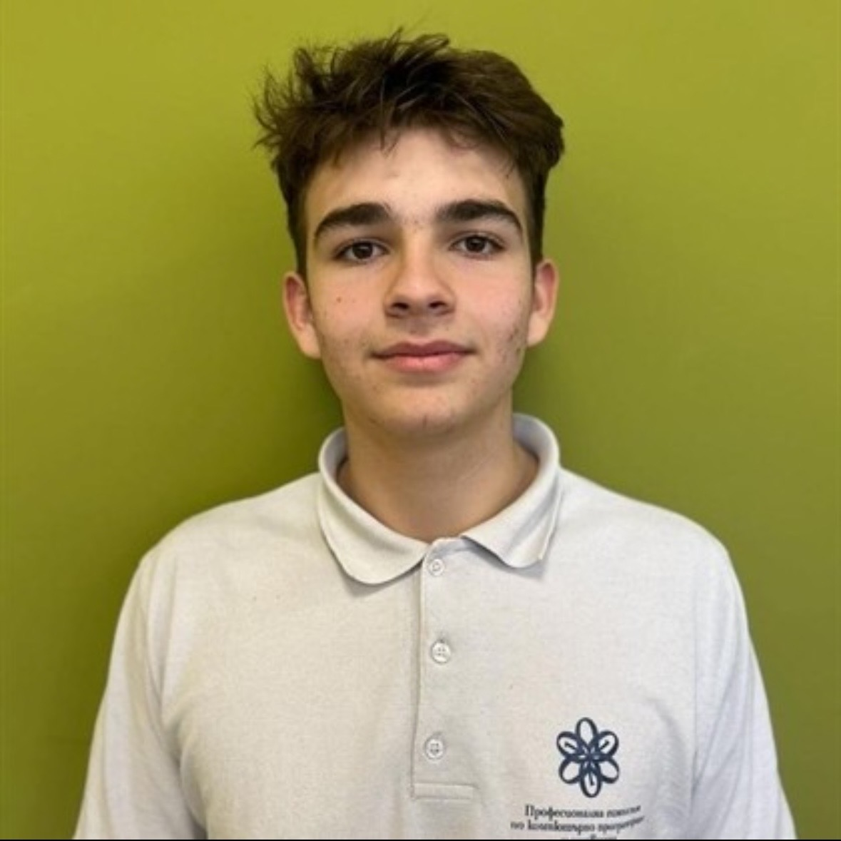
Members
PATanchev23
MMTsonkov23
VictorNikolov
Aleksandar Petrov
-Scrum Trainer-
-Front End Developer-
-Back End Developer-
-Designer-

Slide 4

Our idea
Our idea is to create a literature test game where you answer questions about books, authors, and themes to score points and finish the test.

Slide 5
Planning stages
Creating our team
Making our
idea
Making our
project
Presenting

Slide 6







Technologies

Slide 7
Now lets move
to our game

